Slide 1
Hour 10a
Creating Your First Object (continued)

Slide 2
Review

Slide 3
Review
Keywords
break
case
class
continue
default
do
else
extends
final
if
import
loop
public
static
switch
void
while
Special characters
( )
{ }
[ ]
Operators
= - assignment
+ - add/concatenate
- - subtract
* - multiply
/ - divide
% - modulus
++ - increment
-- - decrement
+= - increment assign
? : - conditional/tenary
Types
boolean
byte
char
double
float
Graphics
int
long
short
String
API Calls
Double.parseDouble()
Graphics.drawString()
Integer.parseInt()
Math.sqrt()
String.equals()
String.indexOf()
String.length()
String.toLowerCase()
String.toUpperCase()
System.out.print()
System.out.println()

Slide 4
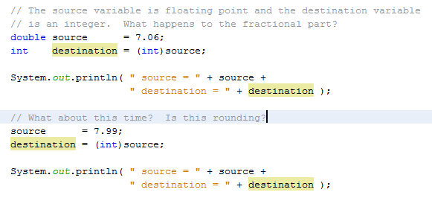
Converting Objects and Simple Variables
Casting is used to convert from one type of data to another
Source – the original form of the data
Destination – the converted form of the data
Casting Simple Variables

Slide 5
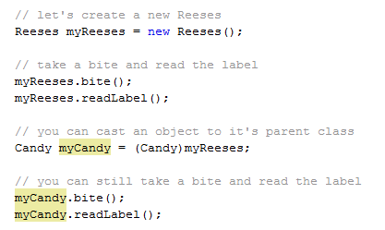
Converting Objects and Simple Variables
Casting Objects
You can cast an object to its parent class

Slide 6
Converting Objects and Simple Variables
Converting Simple Variables to Objects and Back
There are classes corresponding to every base type in Java
Boolean – boolean
Byte – byte
Character – char
Double – double
Float – float
Long – long
Short – short
Integer - int
These classes contain many useful methods/behaviors/functions

Slide 7
Summary

